Slide 1

PARAPHRASING
How to Restate Ideas Without Changing Meaning
SAJJAD HOSSAIN
Faculty, UIU

Slide 2




LEARNING OUTCOMES
Define paraphrasing
Understand core guidelines and characteristics .
Achieve actionable rewriting techniques (synonyms, grammar, voice).
Practice applying these skills to real text samples
Recognize the importance of paraphrasing in avoiding plagiarism

Slide 3





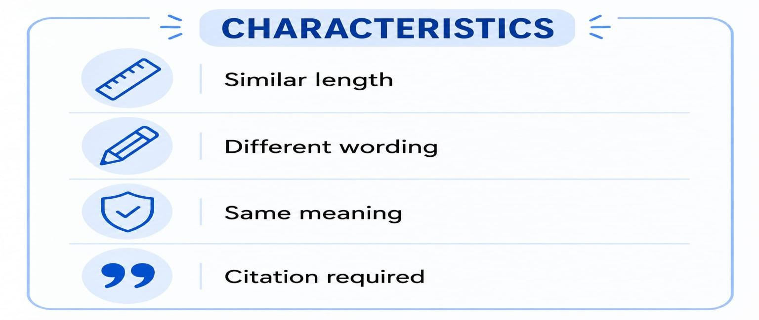
WHAT IS PARAPHRASING ?
means expressing someone else’s ideas in you own words while keeping
the original meaning .

Slide 4
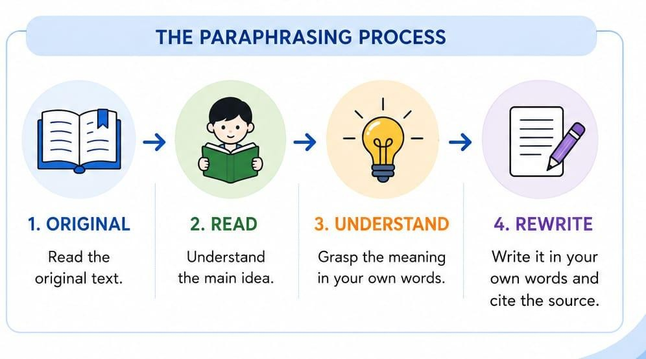
PARAPHRASING PROCESS

Slide 5
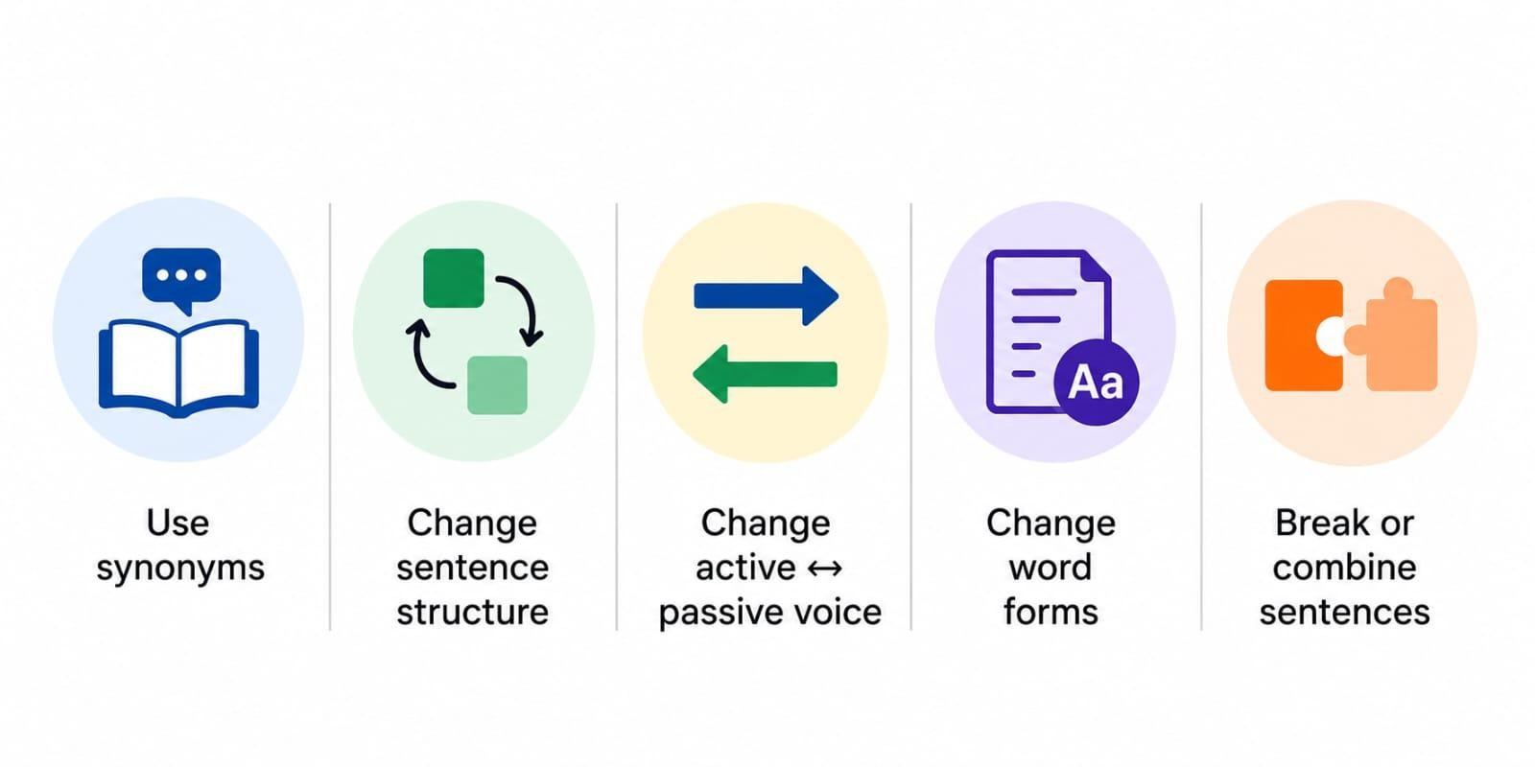
TECHNIQUES OF PARAPHRASING

Slide 6
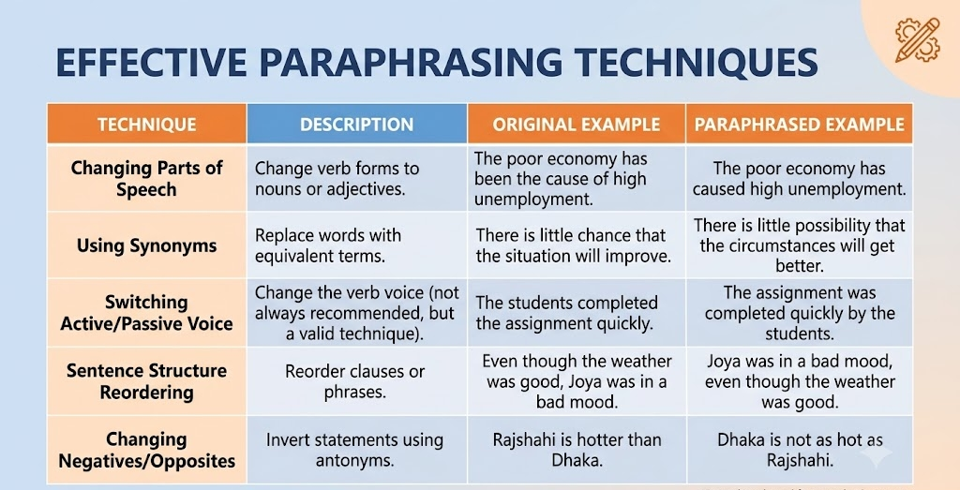

Slide 7
PARAPHRASING EXAMPLE
ORIGINAL : Social media has changed the way people communicate worldwide.
PARAPHRASE : The way people communicate around the Globe has been transformed by social media.
IS THE MEANING STILL SAME

Slide 8
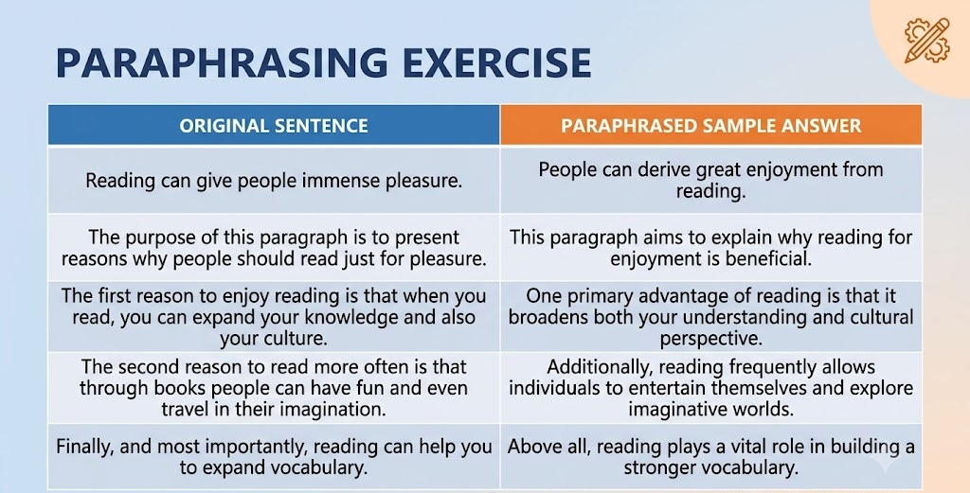

Slide 9
PARAPHRASING PRACTICE
Although he was exhausted, he stayed up late to finish his project.
The heavy traffic delayed our arrival at the airport by an hour.
She saves a portion of her salary every month to buy a new car.
The power outage left the entire neighborhood in pitch darkness.
He was offered the job because of his extensive experience in marketing.
Drinking enough water daily is essential for maintaining good health.
The chef prepared a special dish to celebrate the restaurant's anniversary.
She turned down the job offer because the location was too far from home.
Many people prefer working from home because it saves commuting time.
The team won the championship after months of rigorous training.

Slide 10


PASSAGE EXAMPLE
ORIGINAL PASSAGE
PARAPHRASE
Many students spend several hours every day using social media. While social media helps them stay connected with friends and access useful information , excessive use can reduce study time, affect concentration and lower academic performance .Therefore, students should use social media wisely and maintain a balance between online activities and their studies
A large number of students devote multiple hours daily to social platforms. Although these networks allow them to maintain friendships and source helpful data, spending too much time online can decrease their study hours, disrupt their focus, and negatively impact their grades. Consequently, it is vital for students to manage their social media habits responsibly so they can successfully balance their digital lives with their schoolwork.

Slide 11
Classroom Activity & Wrap-up
Activity
Key Takeaway
Task: Take the sentence below and produce a Paraphrased sentence:
"Social media has changed the way people communicate worldwide, offering instant connectivity while introducing challenges in daily productivity."
Paraphrase = Change words and structure; keep length similar.

Slide 12
ANSWER KEYS
Original: Although he was exhausted, he stayed up late to finish his project.
Paraphrase: Despite feeling extremely tired, he remained awake late into the night to complete his work.
Original: The heavy traffic delayed our arrival at the airport by an hour.
Paraphrase: Severe congestion on the roads pushed our airport arrival time back by 60 minutes.
Original: She saves a portion of her salary every month to buy a new car.
Paraphrase: Each month, she sets aside part of her earnings to purchase a vehicle.
Original: The power outage left the entire neighborhood in pitch darkness.
Paraphrase: A blackout plunged the whole community into complete shadow.
Original: He was offered the job because of his extensive experience in marketing.
Paraphrase: His rich background in marketing earned him the position.
Original: Drinking enough water daily is essential for maintaining good health.
Paraphrase: Staying properly hydrated every day is vital for overall well-being.
Original: The chef prepared a special dish to celebrate the restaurant's anniversary.
Paraphrase: To mark the restaurant's milestone, the cook created a unique meal.

Slide 13
ANSWER KEYS
Original: She turned down the job offer because the location was too far from home.
Paraphrase: The excessive distance from her house led her to decline the employment offer.
Original: Many people prefer working from home because it saves commuting time.
Paraphrase: Remote work is favored by many as it eliminates travel time.
Original: The team won the championship after months of rigorous training.
Paraphrase: Months of intense practice paved the way for the team's tournament victory.

Slide 14
THANK YOU

